Slide 1
Poster Board Project
ECE 618

Slide 2
Scrum Master
Planning & Organization Helped define project direction as a team Created the project planning document Contributed to architecture and tech stack discussions | Team Coordination Created a task spreadsheet to organize responsibilities Helped ensure each member had clear ownership of tasks Set up and maintained group communication (group chat)
Project Setup Created the GitHub repository Defined initial folder structure for team collaboration | Progress Tracking Checked in with team members regularly Tracked what was completed and what remained Helped keep the team aligned on project status and deadlines
Overall Contribution Focused on keeping the project organized and moving forward Supported team collaboration while engineers handled implementation

Slide 3
Frontend - Requirements and Tools
Requirements:
Mobile-first responsiveness
Modular hierarchy
Feed
Post
Post information
Seemless “scrolling” when on the feed page
Support for display and upload of multiple file types
NPM packages should be included for easy deployment
Development Tools and Tech Stack:
Next.js + typescript for web app
Tailwind CSS for styling
OpenAI Codex used to generate code
Playwright + ChatGPT used for automated testing

Slide 4
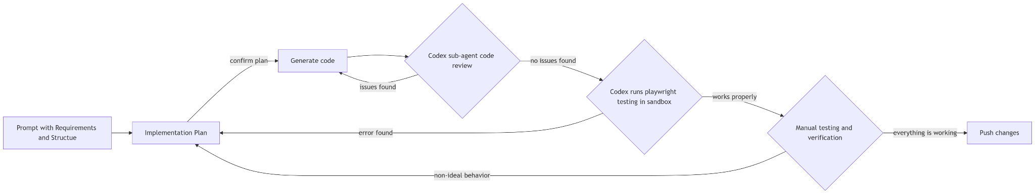
Frontend - Development Process
Issues faced in development process:
Creating the frontend to be fit to the backend and also be flexible for future implementation of new features and backend changes
File upload and user creation processes and pages
Ensuring simplicity in AI generated frontend code
Agentic Coding Workflow:

Slide 5
Backend: Requirements and Tools
Requirements :
PostgreSQL database that integrates with Frontend to store user posts and data
API endpoints that work with frontend for data tracking and manipulation
Cross origin support for frontend and backend integration
Infrastructure/Tech Stack
Flask web framework with SQL Alchemy ORM, PostgresSQL database
Implementation flask app factory pattern separating models, routes, and services
Database migrations/Updates: Implemented Alembic for schema verison control and database evolution
Copilot for code generation and review

Slide 6
Backend: Database Models
User Model
ID (primary key)
Username (unique constraint)
Created timestamp
Relationship to posts with cascade delete
Post Model
ID (primary key)
Title and content fields
Image URL storage
User foreign key relationship
View count tracking (for analytics)
Created/uploaded timestamps

Slide 7
Backend: Development Proccess
Issues
Database usage that doesn’t require the user to download Postgres
Figuring out .env support for database URL usage
APIs:
User Management:
POST /users - Create new user
GET /users - List all users
GET /users?query=text - Search users by username
GET /users/<id> - Get specific user with their posts
Post Management:
POST /posts - Create new post with image
GET /posts - Retrieve all posts
GET /posts/<id> - Fetch single post
DELETE /posts/<id> - Remove post

Slide 8
Testing
Role:
Backend Mock data creating for testing fake routes
Local testing support for use cases
Deliverables:
In memory mock dataset for user & posts
Tested Deployment locally
reduced dependency on database setup
accelerated development and QA

Slide 9
Report
Role:
Role: Documentation author + code reviewer
Clarified architecture
Reviewed code structure
Ensured documentation matched implementation
Deliverables:
Report ensuring documentation matched implementation and team responsibilites

Slide 10
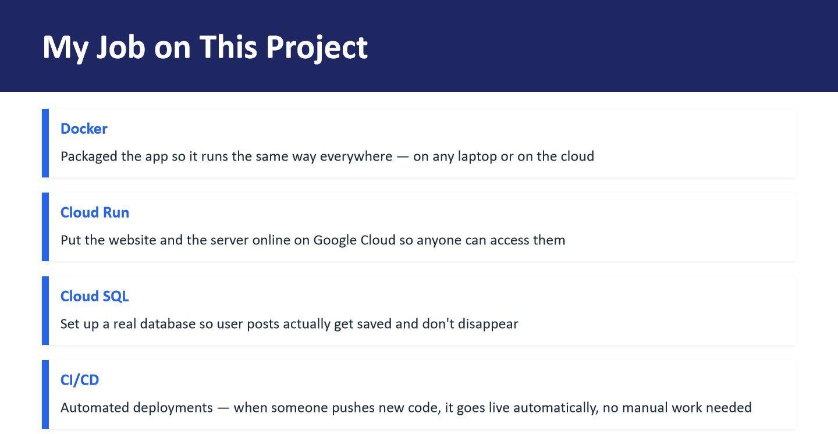

Slide 11
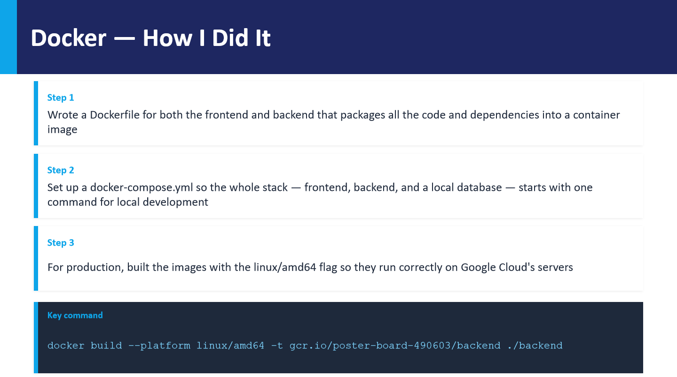

Slide 12
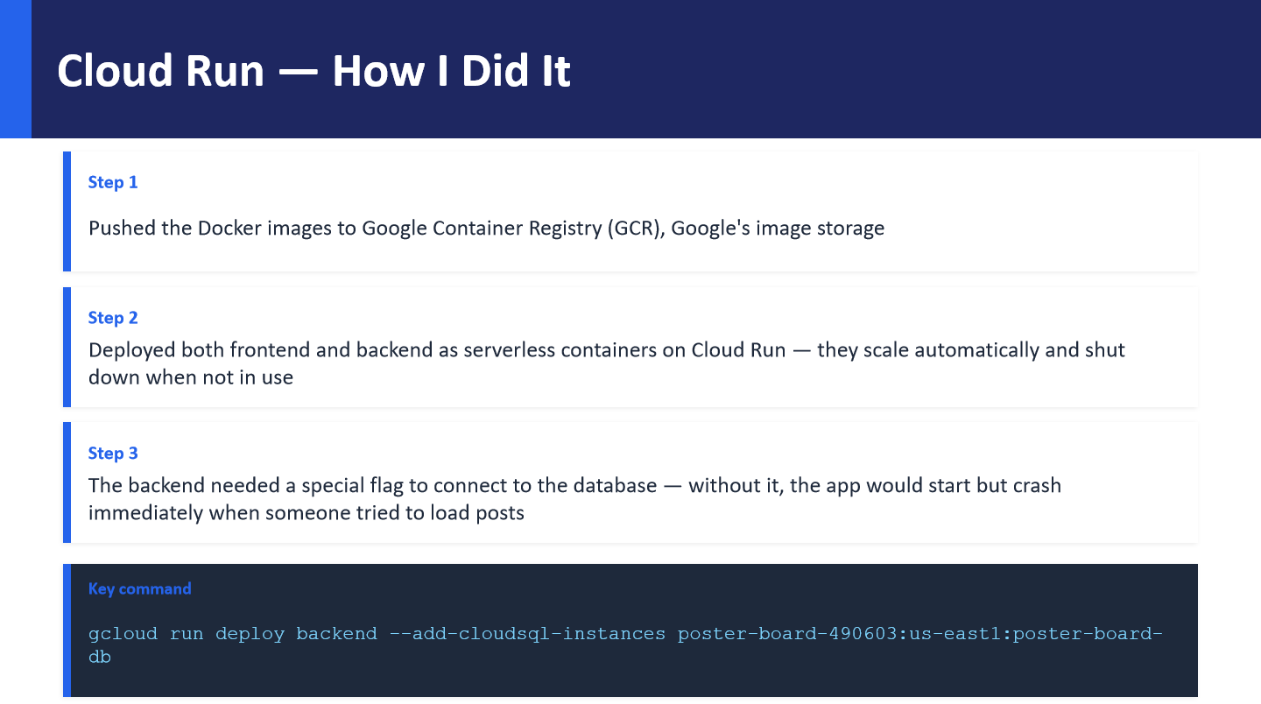

Slide 13
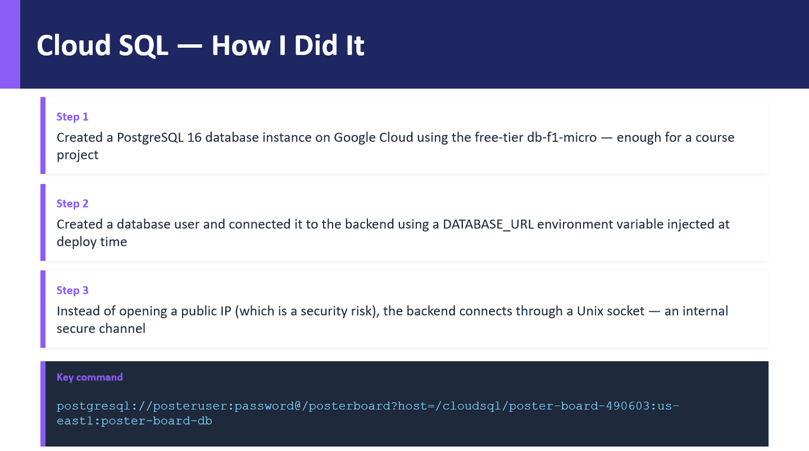

Slide 14
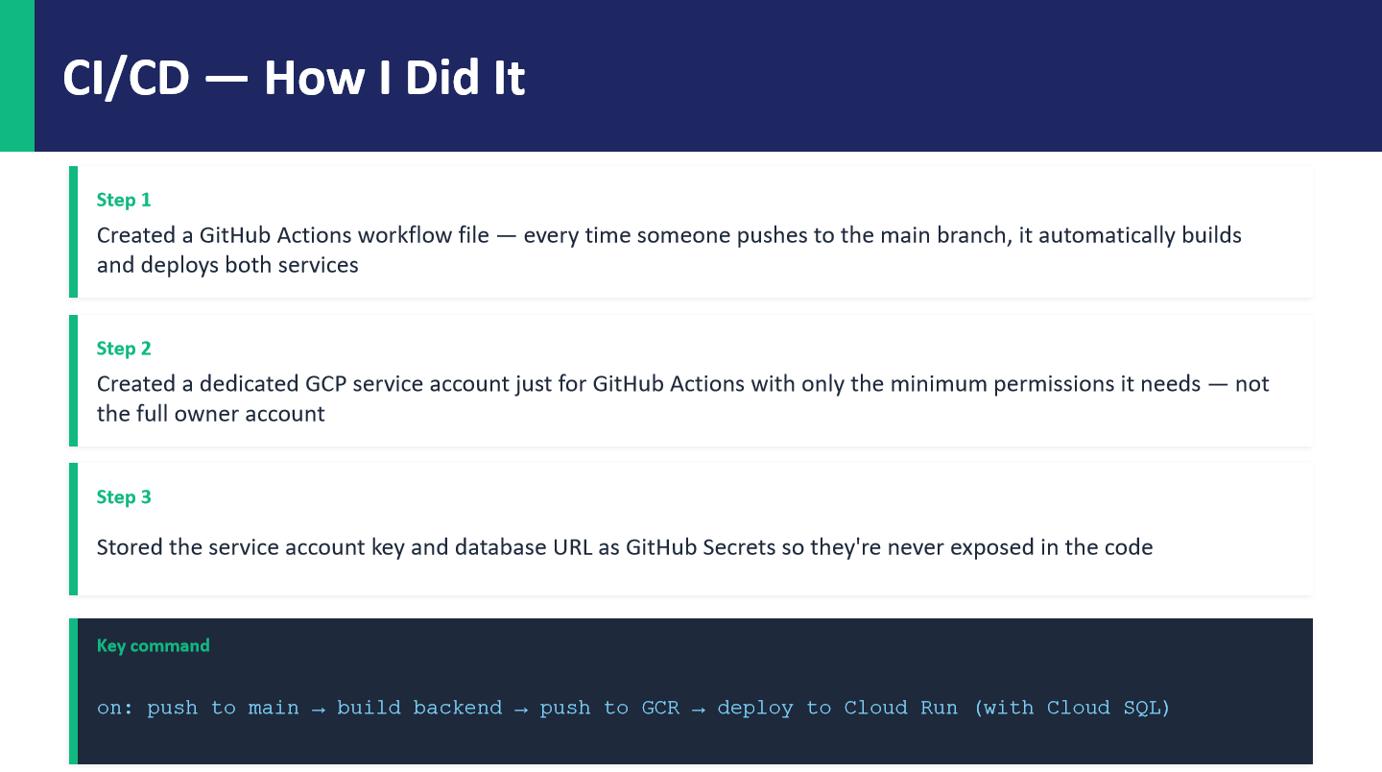

Slide 15
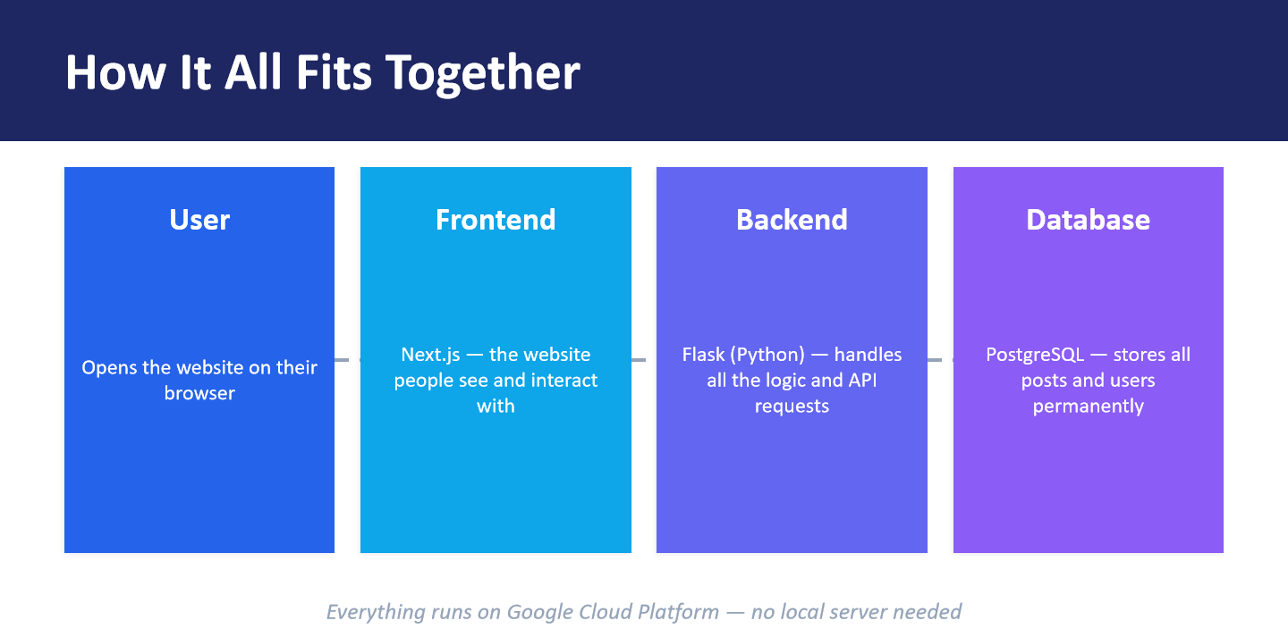

Slide 16
